Slide 1
PowerApp - README
The PowerApp sample solution includes the following components
PowerOperator4IoTEdge – Canvas App
PowerAutomate2IoTEdgeCTL – PowerAutomate to call REST API
Entities(Tables) – to hold module, device, edge and deployment information
PowerApp uses the Dataverse (formerly known as Common Data Service) to store information regarding modules, devices, edges, etc.
In its current version the data for module names is not integrated between Dataverse and CosmosDB, hence will need to be manually added to the Dataverse

Slide 2
Environment
An environment is a space to store, manage, and share your organization’s business data, apps, and flows. (About Environments)
For the installation you could using an existing environment or start with a new environment
This documentation assumes new environment

Slide 3
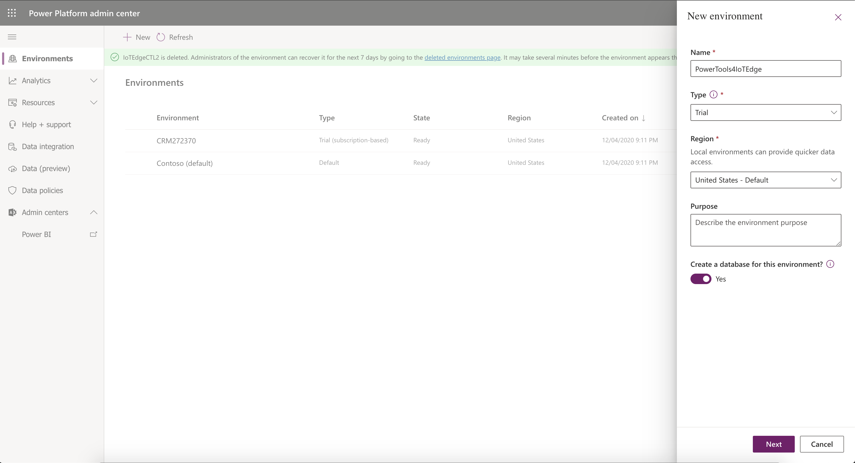
This example starts with creating a new Environment, you can start in an existing environment as well. Here is instructions to create a new PowerApp environment.

Slide 4
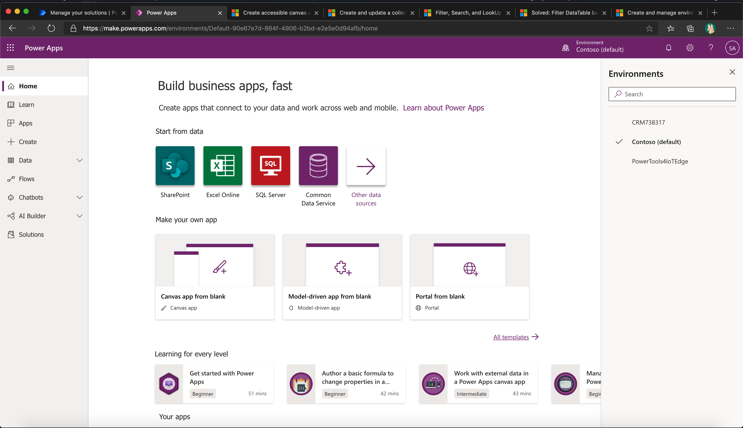
1
2
After creating the environment, navigate to make.powerapps.com and select your environment

Slide 5
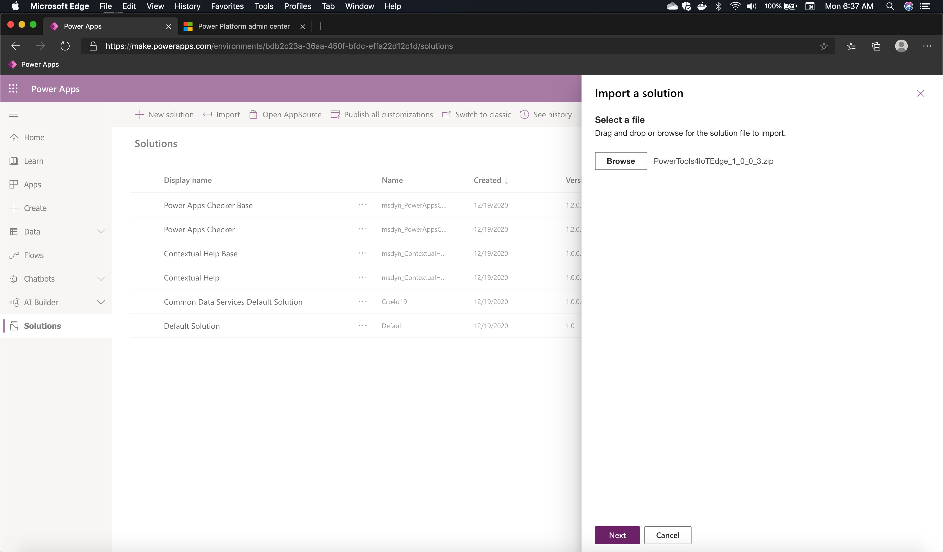
2
1
Navigate to Solutions and select import

Slide 6
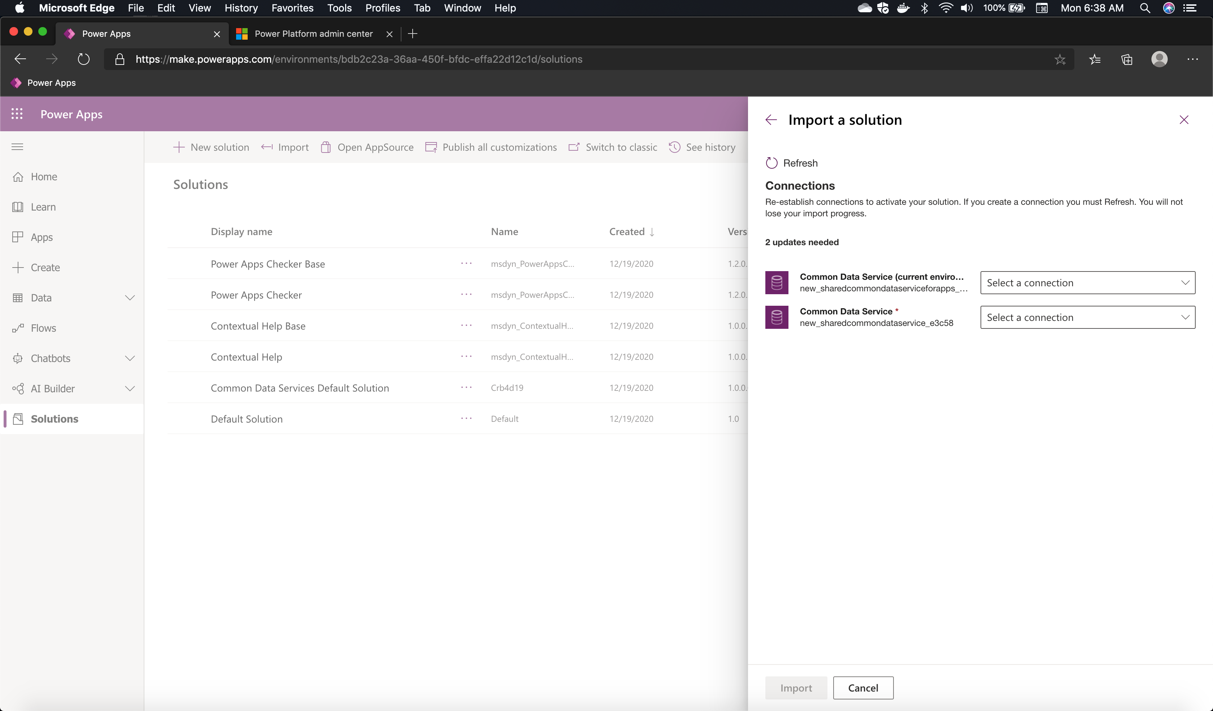
Create Connections for PowerApp and PowerAutomate to connect to Dataverse

Slide 7
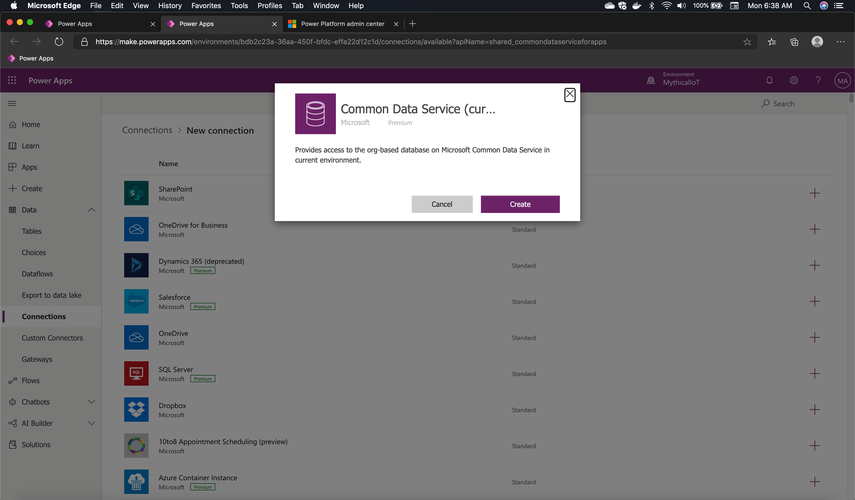
Create Connections for PowerApp and PowerAutomate to connect to Dataverse

Slide 8
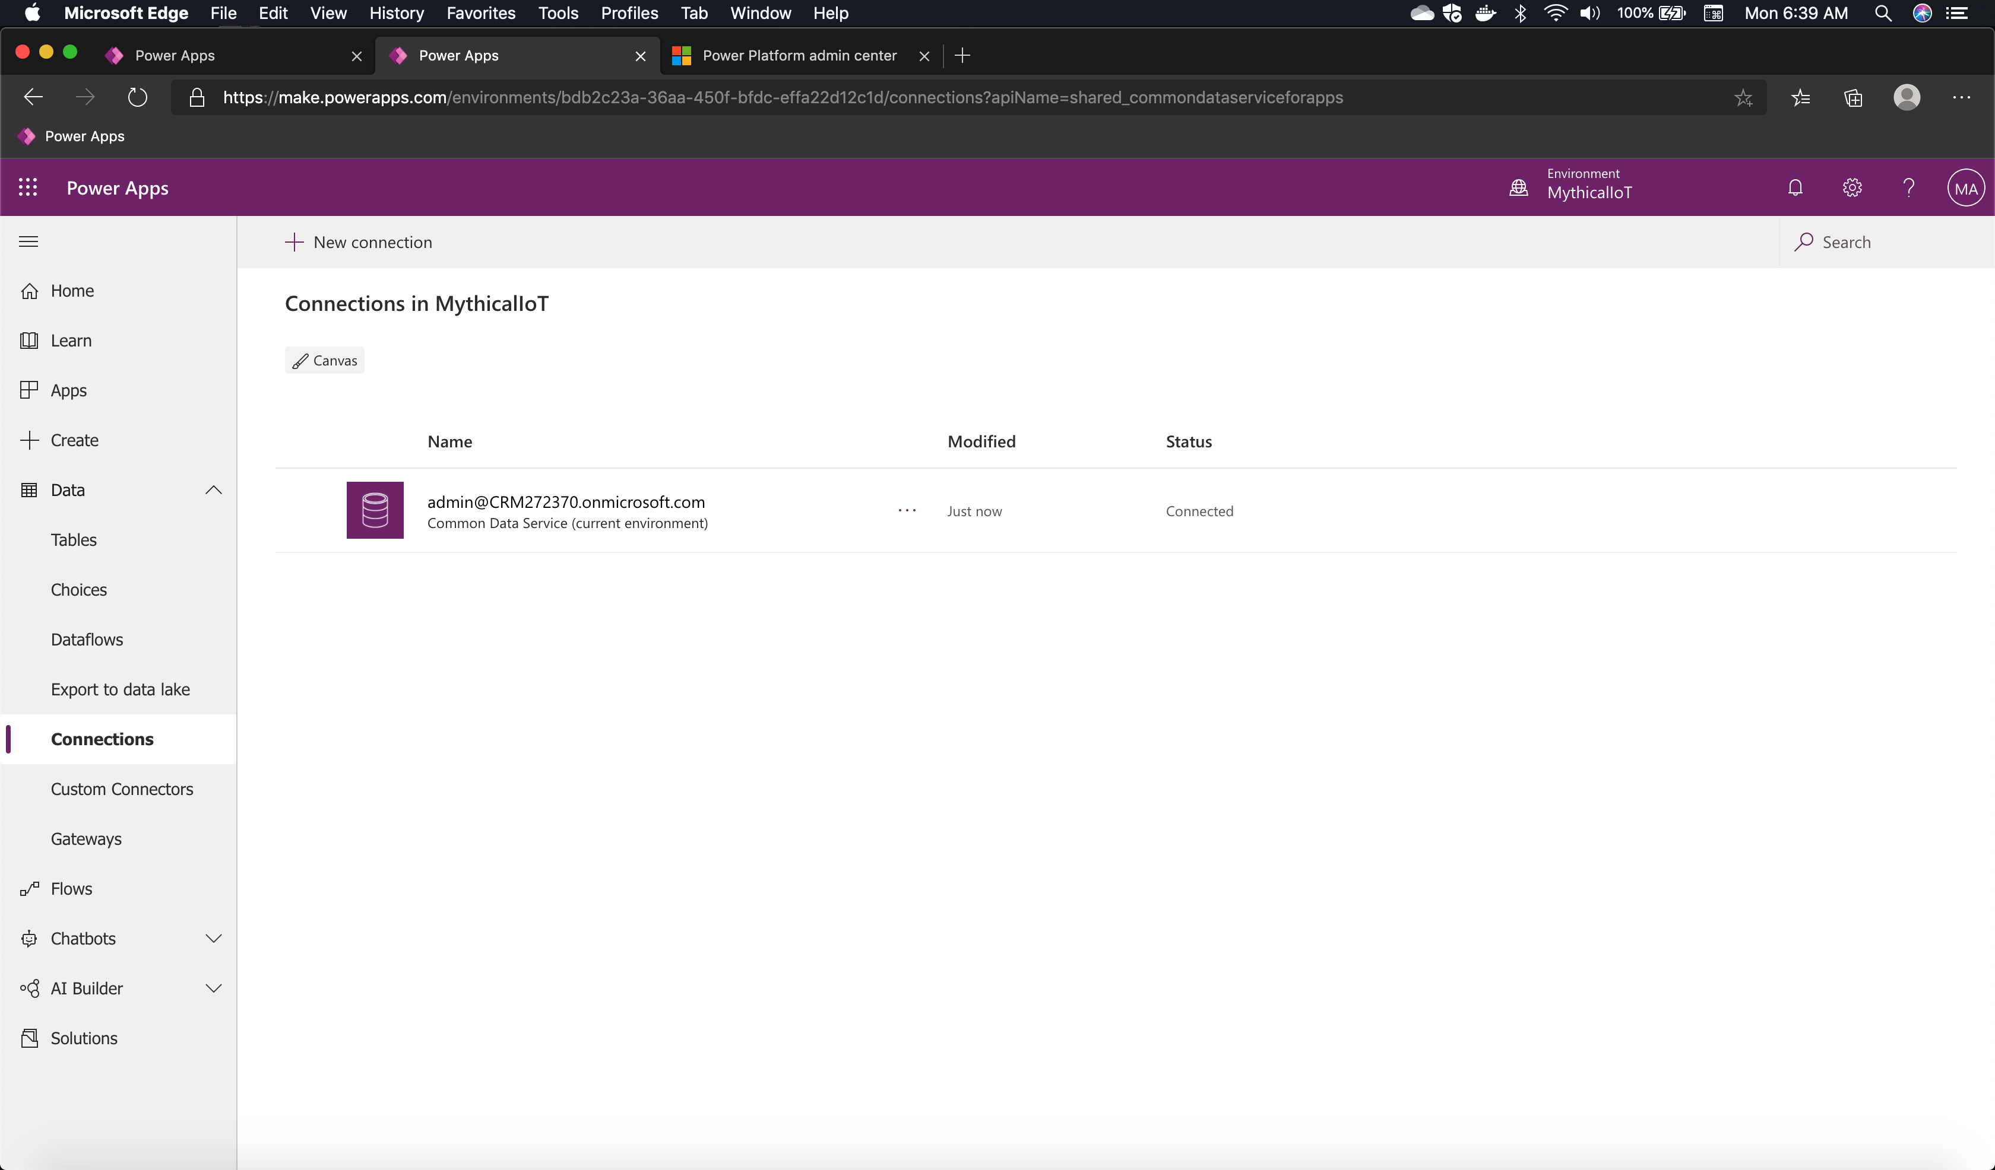
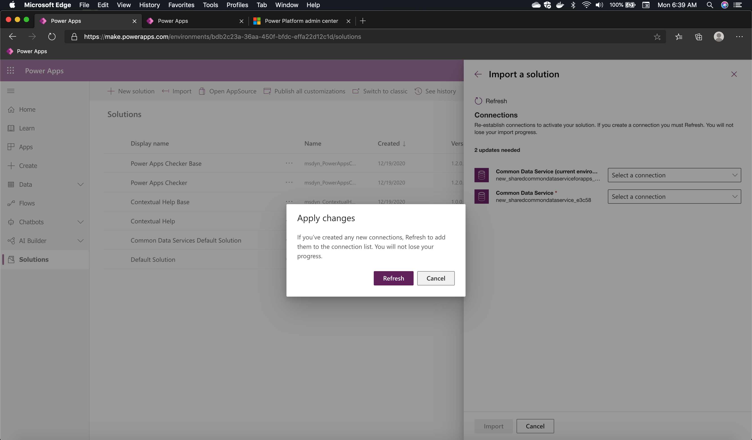
Click on Refresh

Slide 9
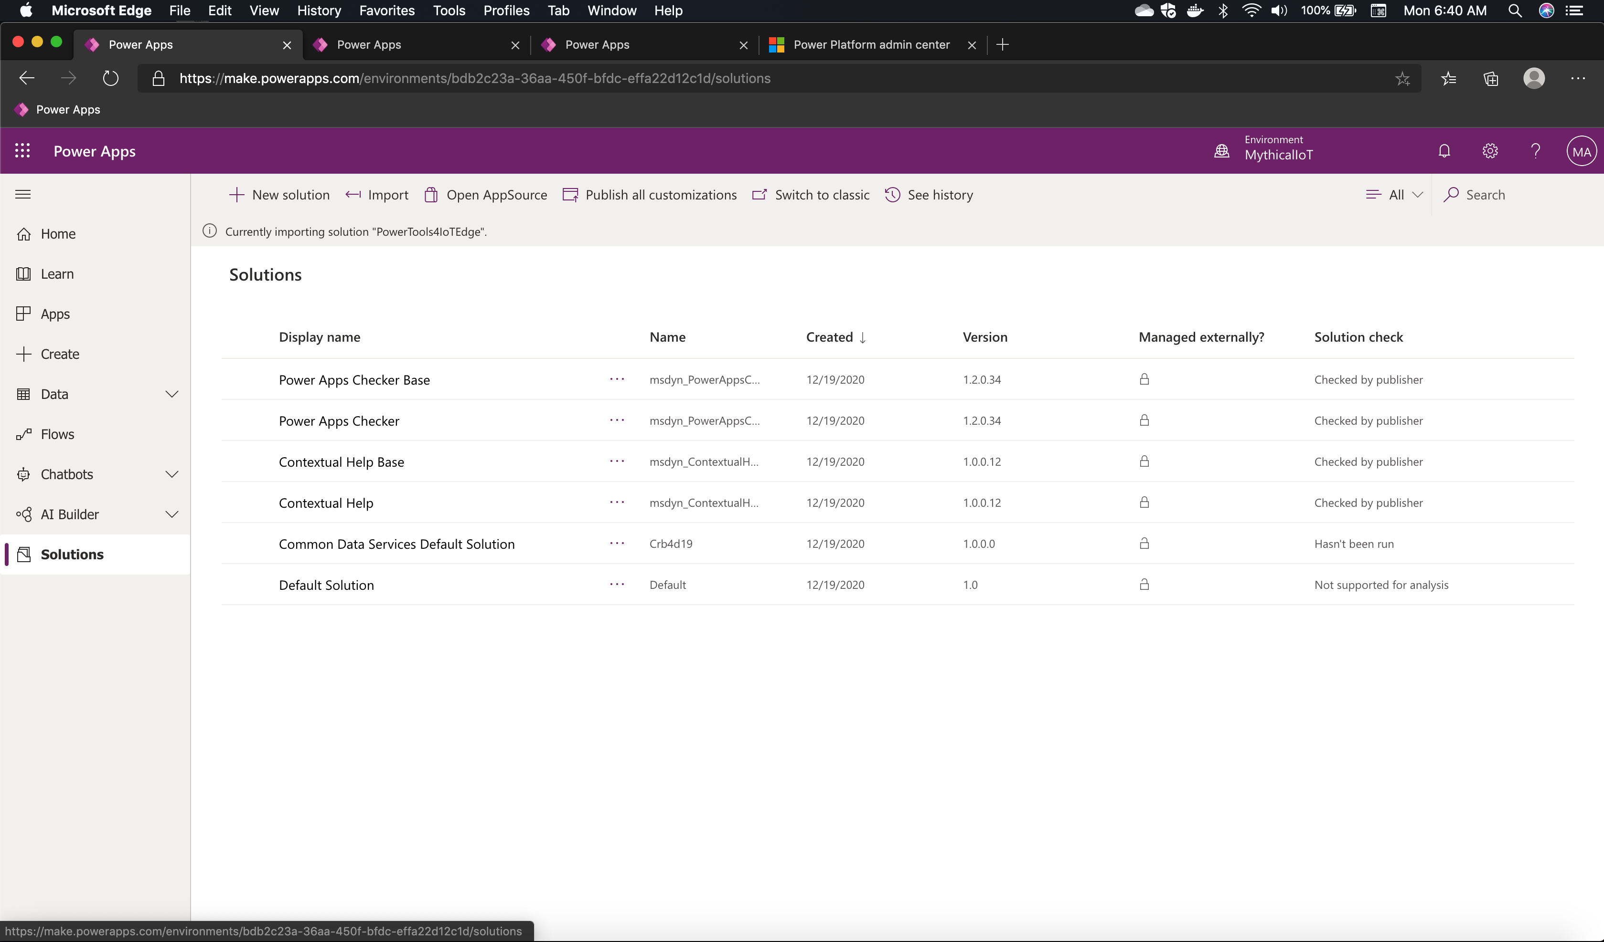
1
After going through the steps for import, the service will start importing the Solution into environment.

Slide 10
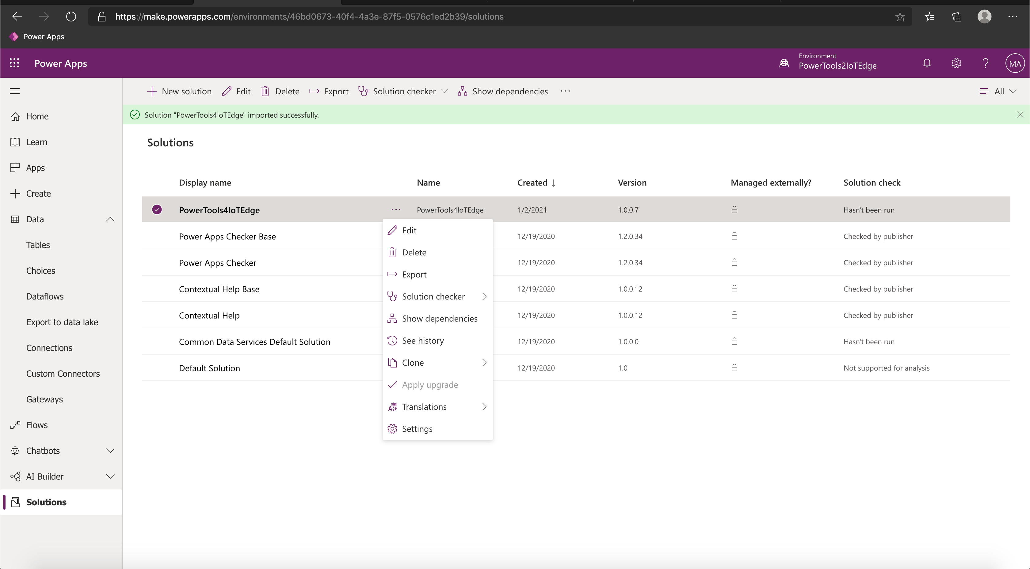
1
On successful import, the solution will show all the components it includes – Connection References, Tables, PowerApp and PowerAutomate.

Slide 11
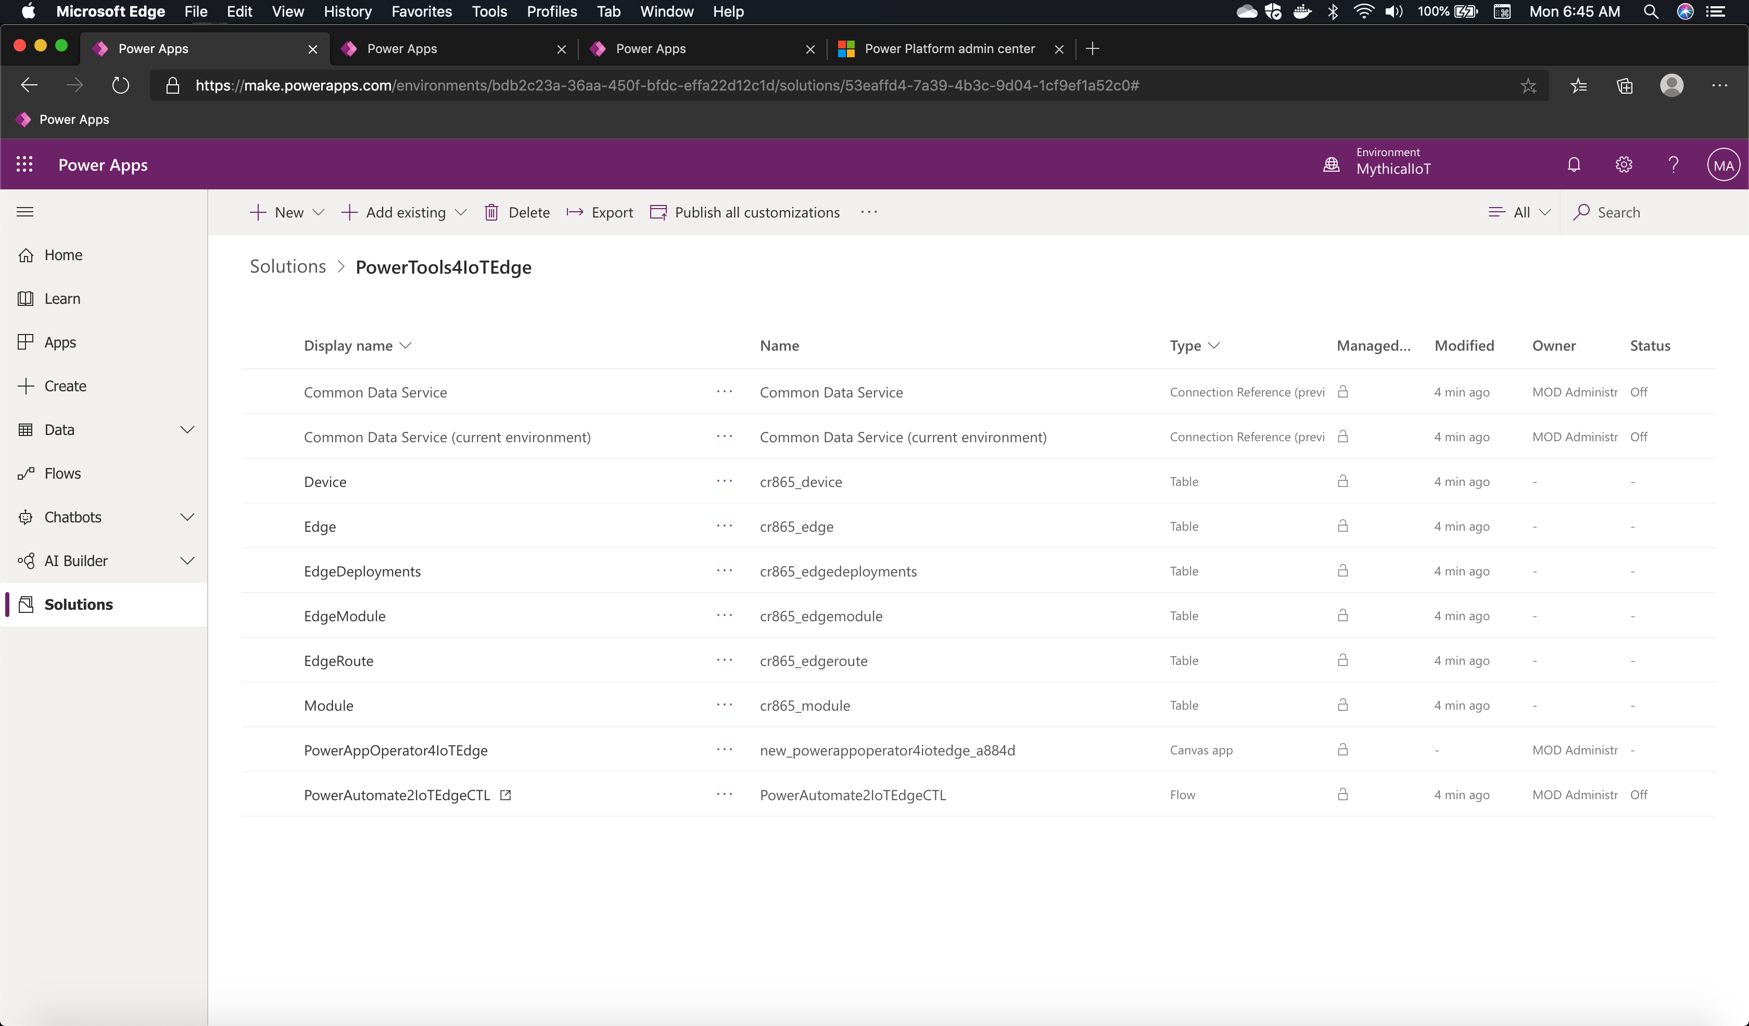
1
On successful import, the solution will show all the components it includes – Connection References, Tables, PowerApp and PowerAutomate.

Slide 12
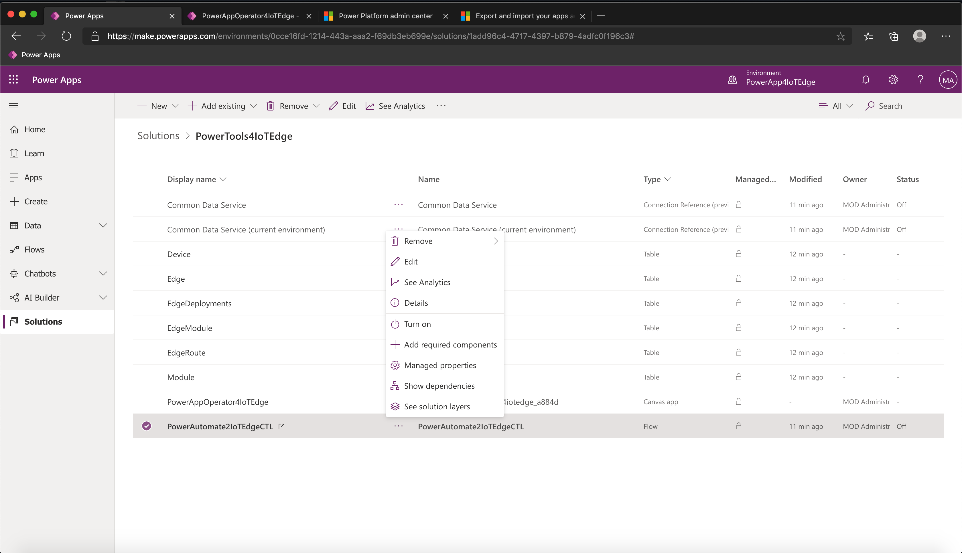
3
1
2
Select the PowerAutomate2IoTEdgeCTL and click on the ellipsis. From the menu click on Edit

Slide 13
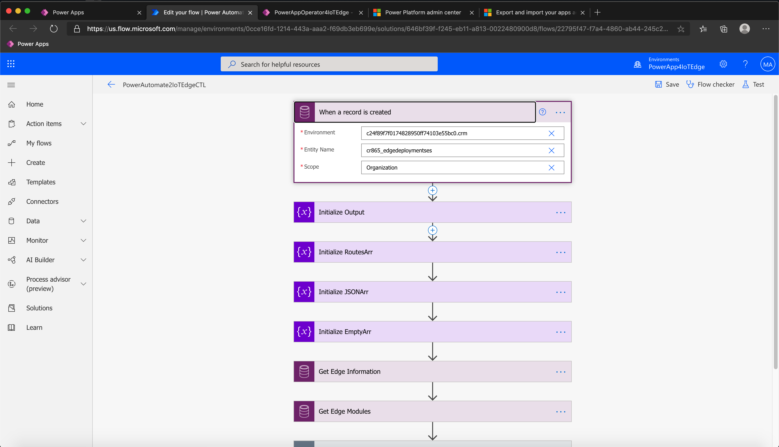
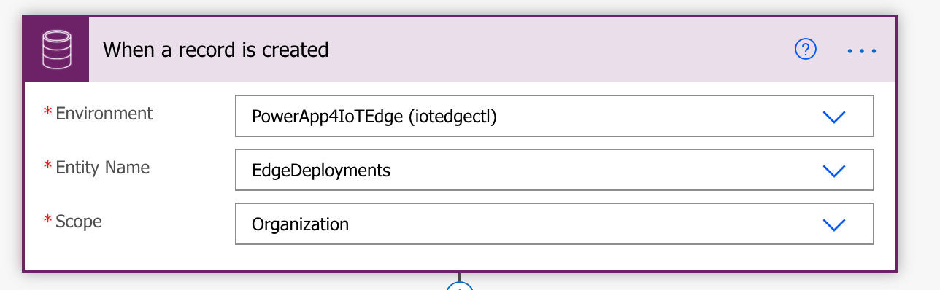
3
1
2
Click on the first activity in PowerAutomate and update the following
Environment : the newly created environment name
Entity Name : edgedeployments

Slide 14
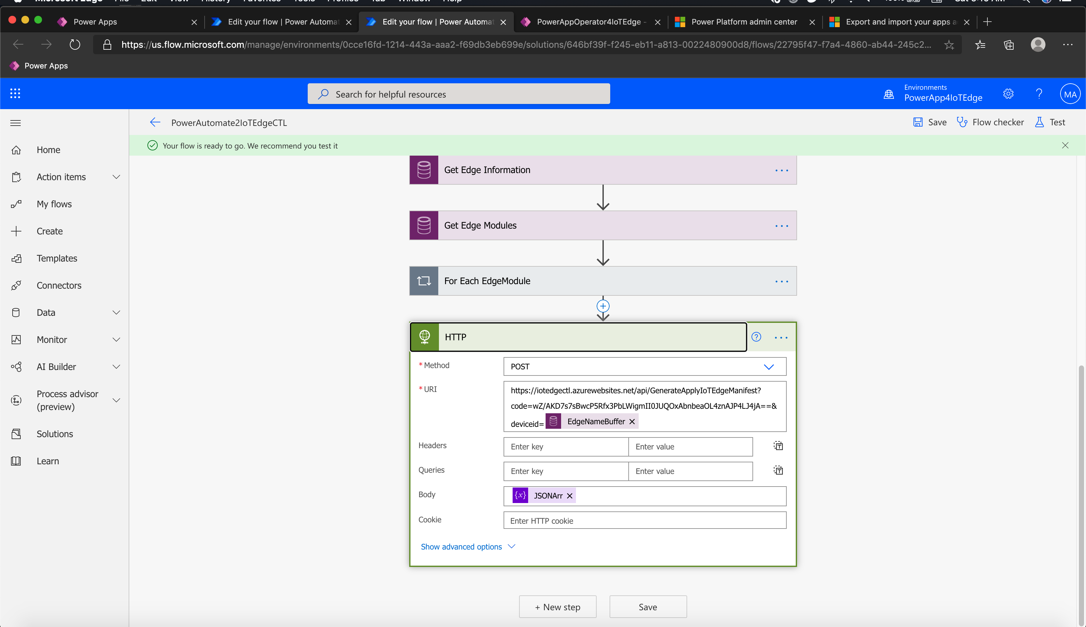
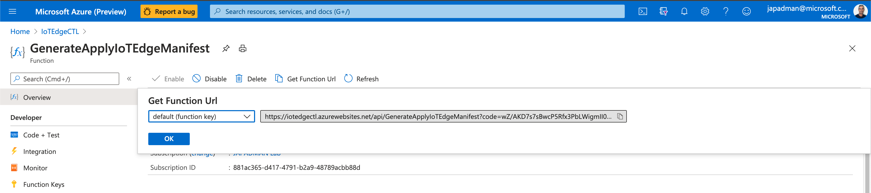
Navigate to the bottom of the PowerAutomate flow and select the step named “HTTP”. This is the step that makes a call to thee REST API that we deployed to Azure. Update this with the appropriate Function URL from deployment into Azure (Navigate to Azure Portal and copy the function url for

Slide 15
3
1
2
Go back to Solutions and Turn on PowerAutomate2IoTEdgeCTL

Slide 16
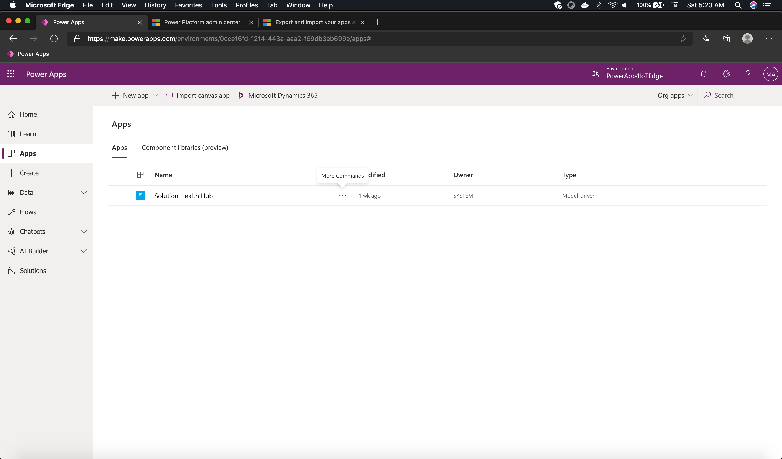
2
1
Navigate to “Apps” and then select Import Canvas App

Slide 17
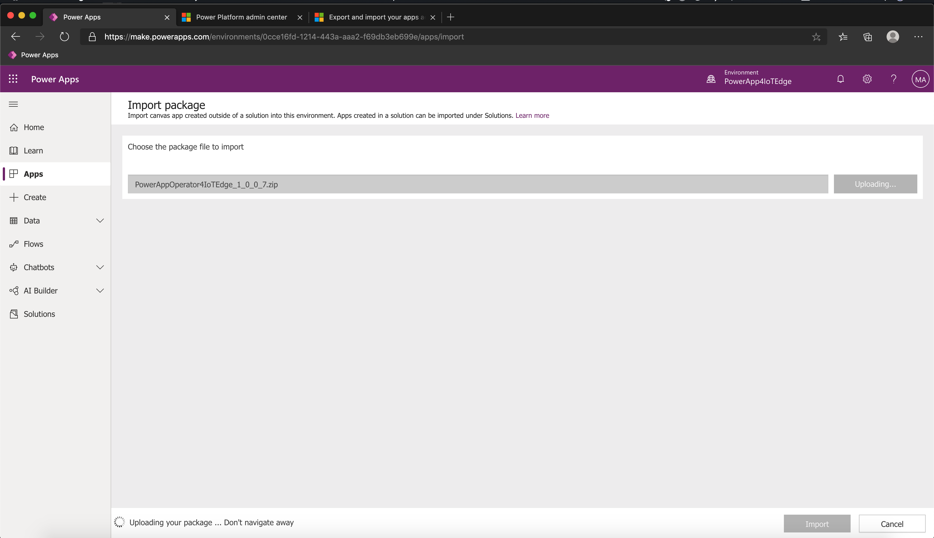
1
Select “PowerAppOperator4IoTEdge_1_0_0_7.zip”

Slide 18
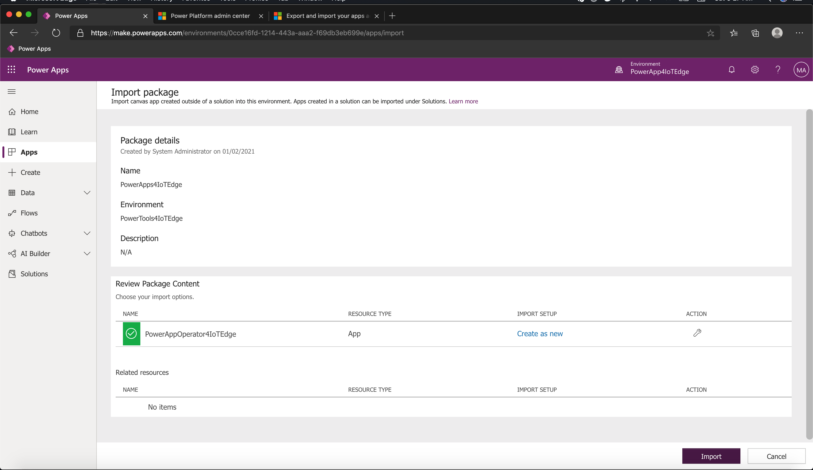
Select Import
1

Slide 19
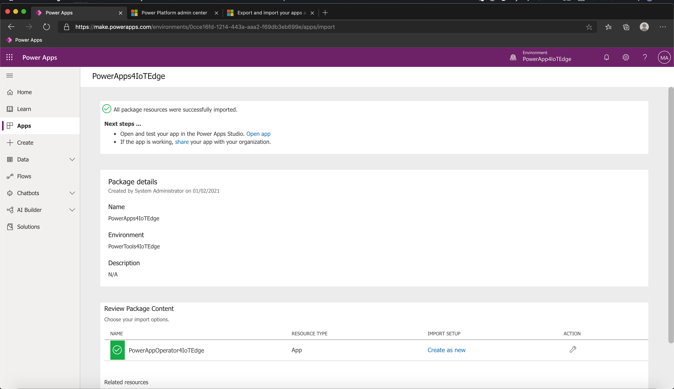
1
Select Open App

Slide 20
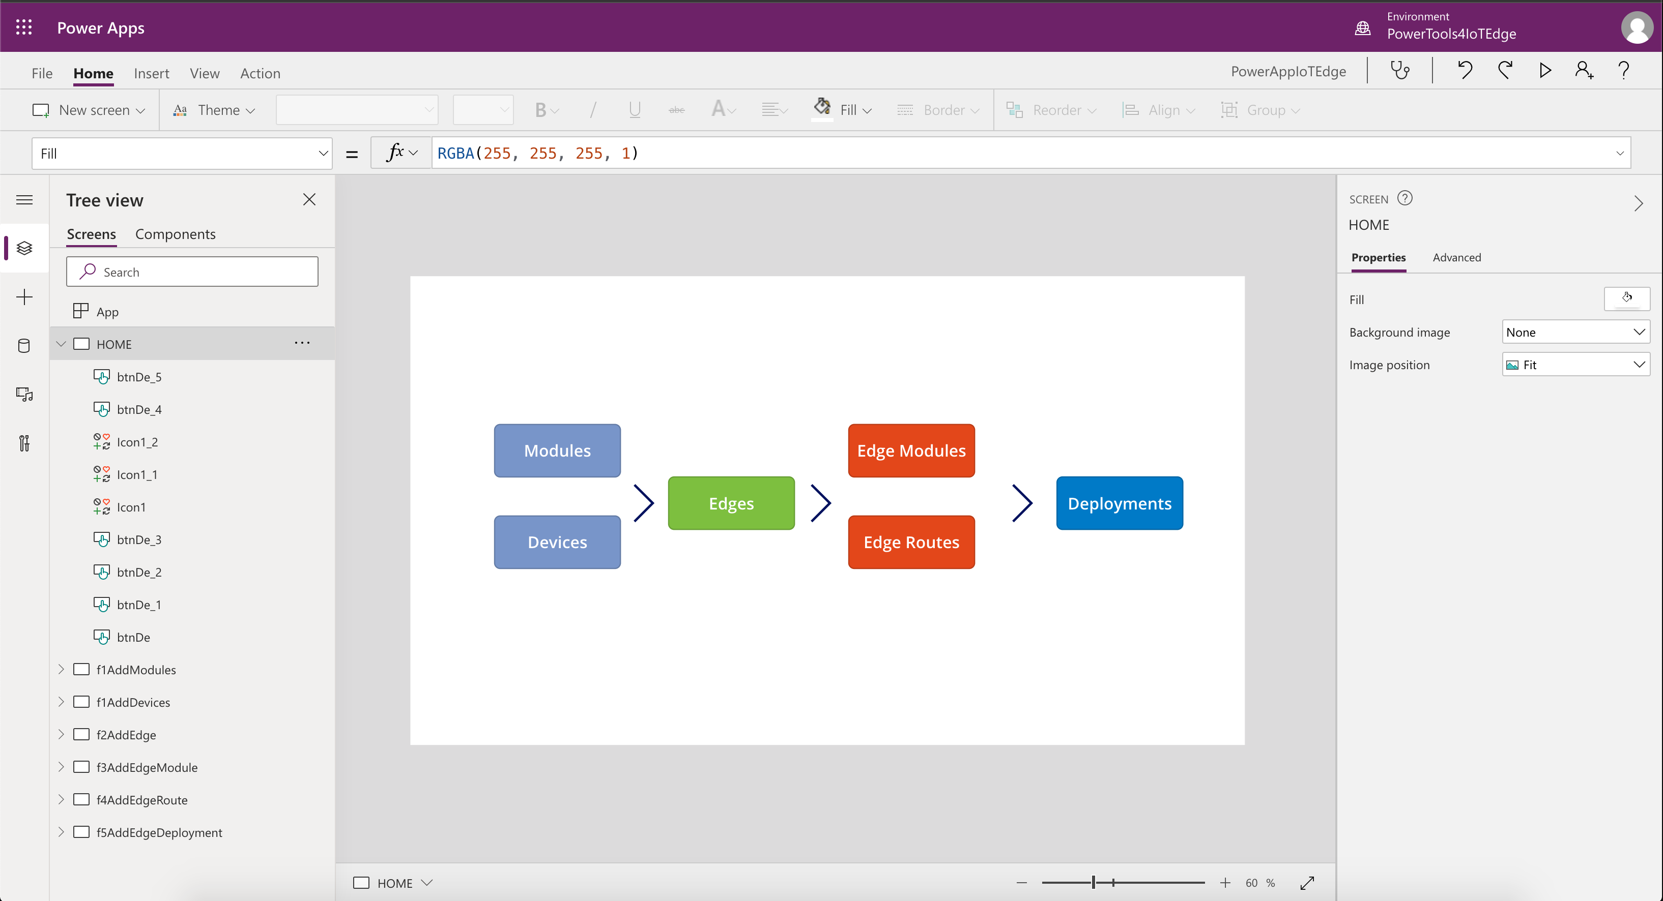
1
The App is now ready to use. Click on Play to run the app.

Slide 21
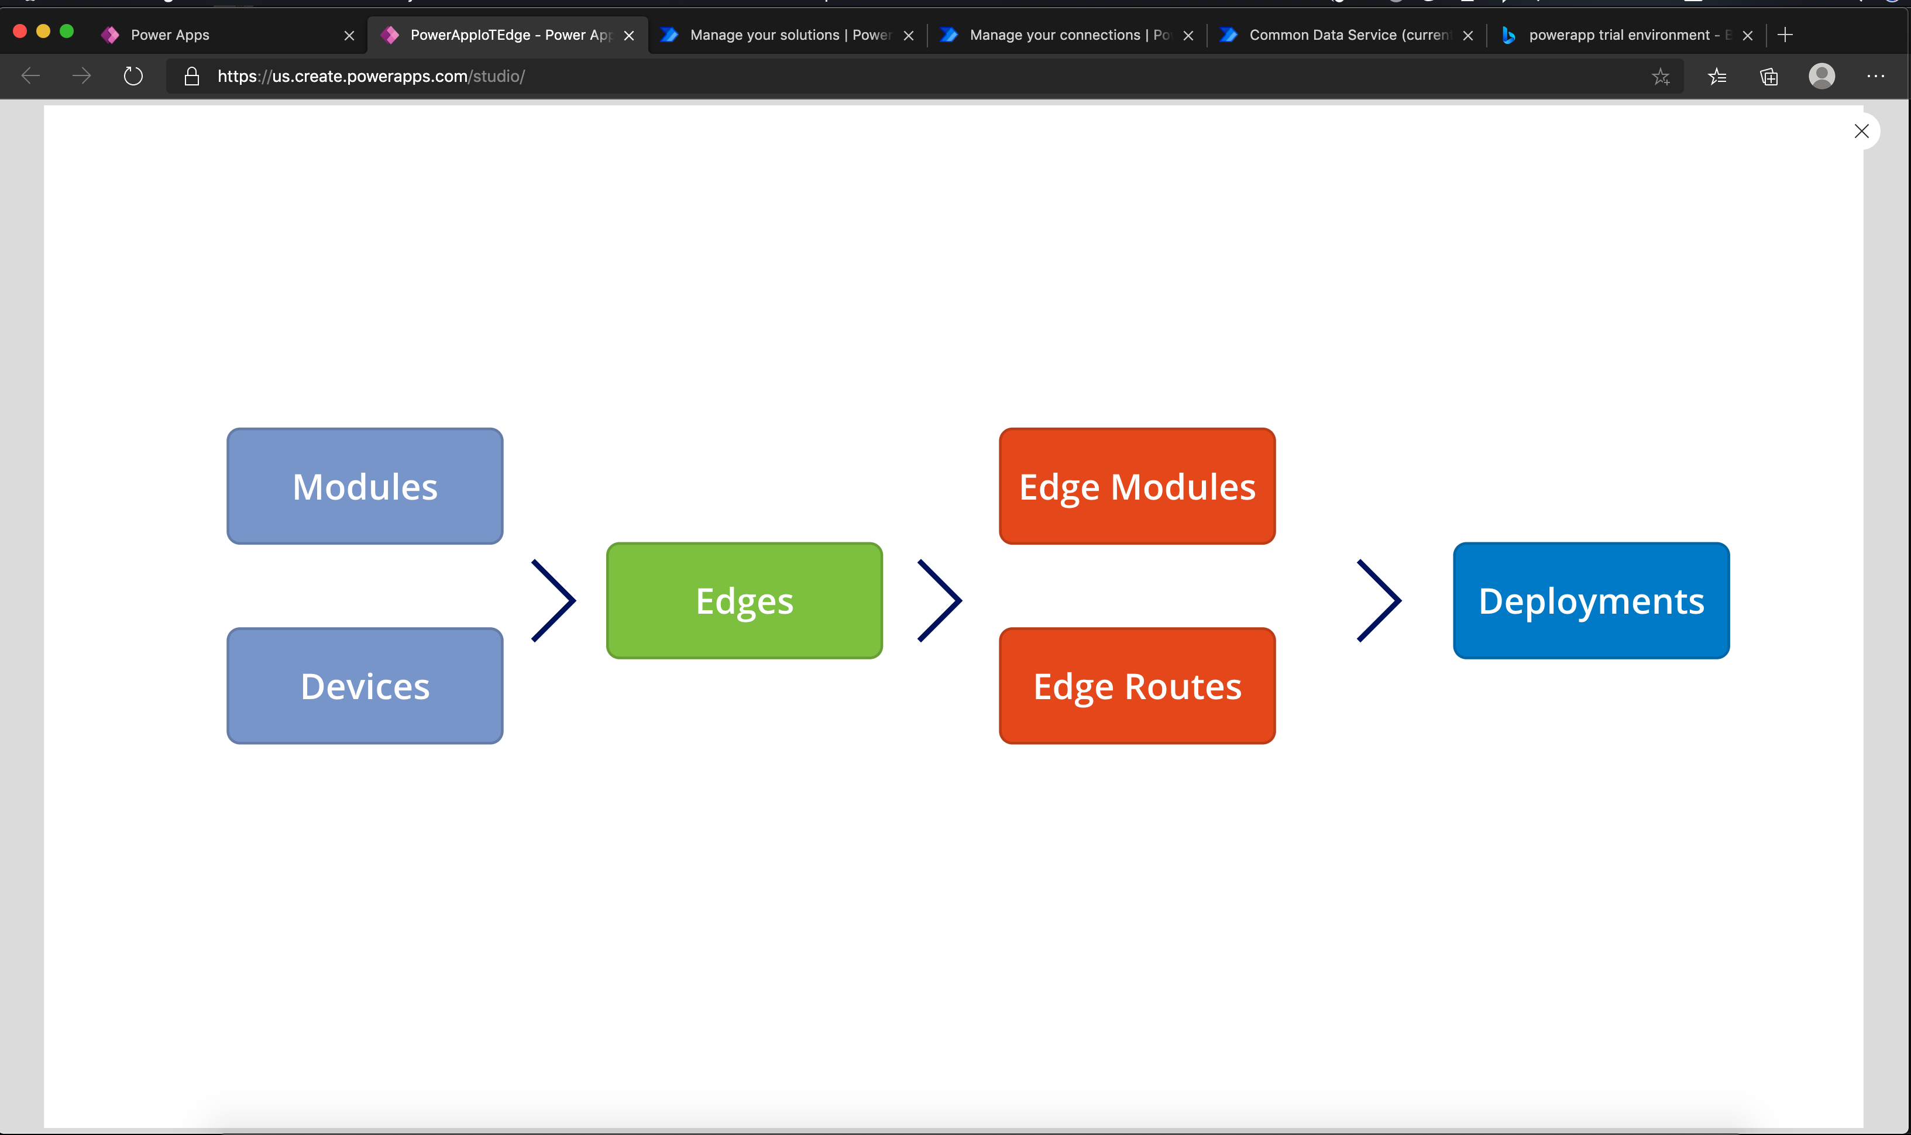
1
Select Modules to create a module

Slide 22
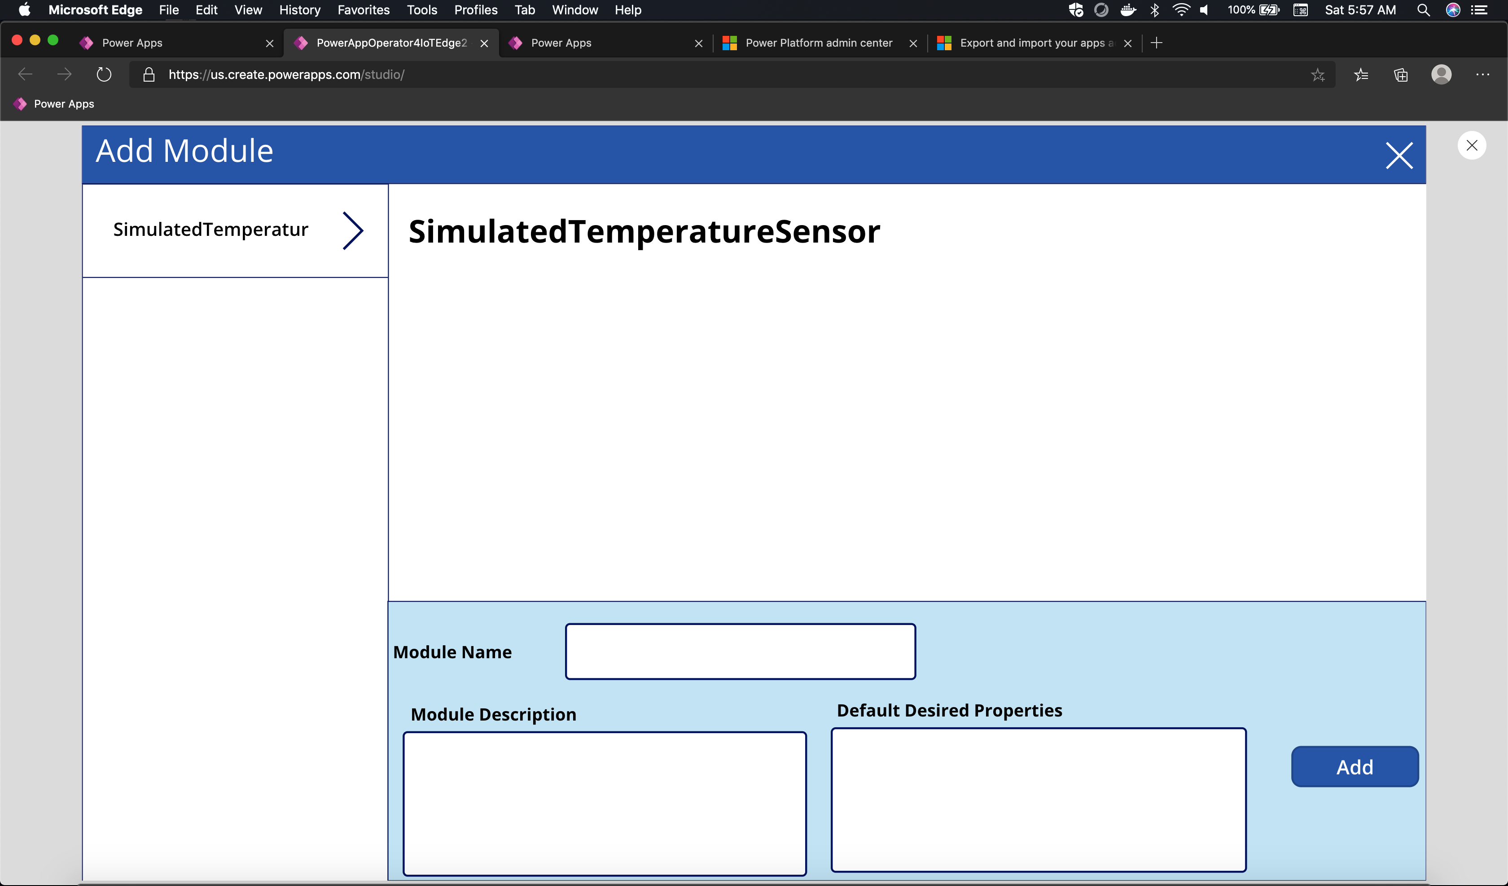
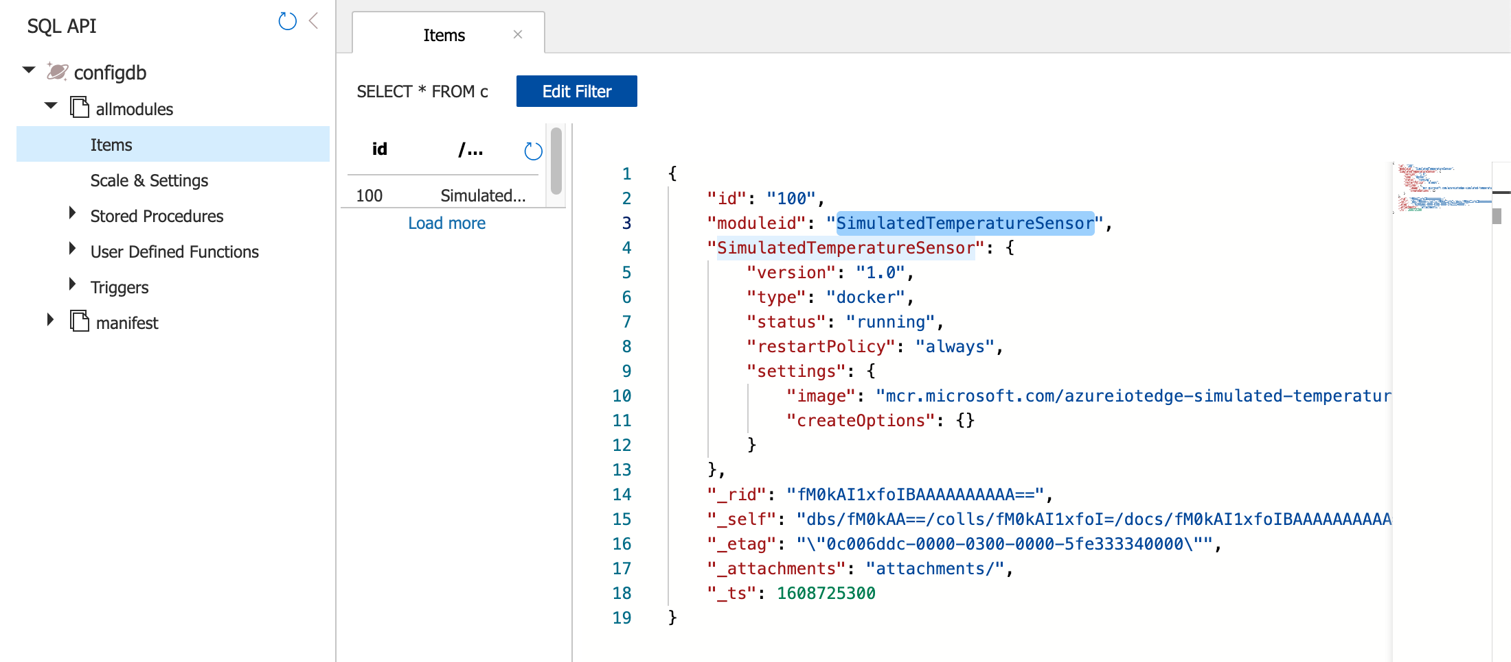
Add sample module that match with what is in CosmosDB. The installation script adds a module “SimulatedTemperatureSensor” in CosmosDB. For every new module added in CosmosDB, the corresponding module name will need to be added to PowerApp module entity

Slide 23
